Slide 1
Before using this slide deck, please read AERO's practice resource, A Whole School Approach to Classroom Management: Facilitation Guide, and follow the instructions for preparing this slide deck.
Notes:
This slide deck supports a session in which staff rehearse circulation. (85–100 minutes)
It includes a video of practice. To play the video, please enable external content if prompted when opening the slide deck.

Slide 2
Circulation:
Practical refinement
Notes:
Before using this professional learning resource, consider using AERO’s professional learning resource, Evidence-Based Approaches for Effective Classroom Management, to build a shared understanding of effective classroom management.
Preparation
Ask participants to:
download the handbook and read Chapter 15: https://www.edresearch.edu.au/classroom-management-handbook
bring a seating plan of their classroom to this session.
Consider also suggesting as pre-reading this short article about rehearsal: https://snacks.pepsmccrea.com/p/rehearsal-in-pd
Remember to delete the preparation section in each slide note once you’ve followed its instructions so that you can more easily see the facilitator notes.
Facilitator notes
If you’re using Presenter View, increase the space for slide notes by dragging the vertical and horizontal lines beside it. You can also adjust the font size using the 2 buttons below the slide notes.

Slide 3
Acknowledgement of Country
Notes:
Preparation
Edit this slide to reflect the way your school acknowledges Country.

Slide 4
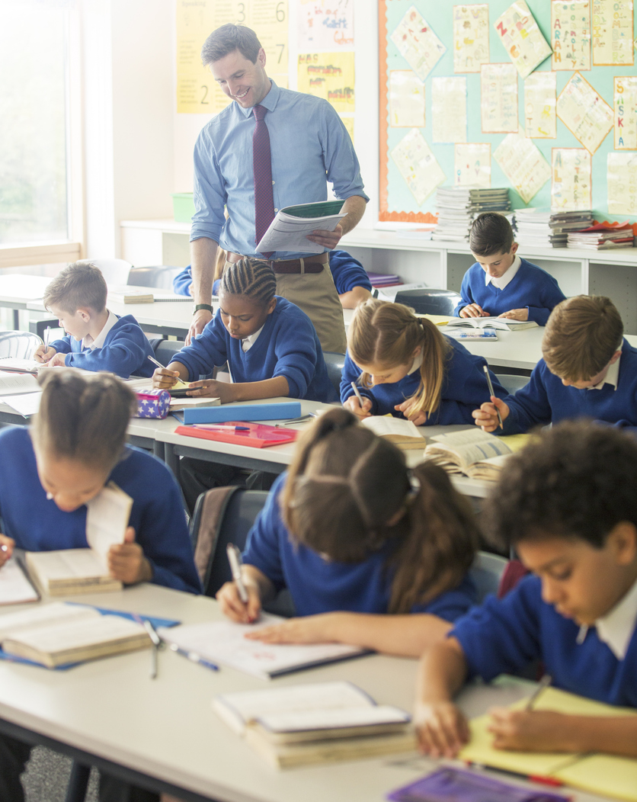
Purpose of this session
To refine our classroom management by rehearsing circulation.
Image credit: iStock.com/Caiaimage/Chris Ryan
Notes:
Preparation
Identify connections between this session and the school's strategic planning goals, whole-school data, and data that captures the perspectives of the school community. Share these with staff prior to or at the beginning of the session to strengthen the rationale for refining classroom management practice.
Consider providing time at the start of the session (for example, 10 minutes) for staff to review the pre-reading.
Participants will rehearse in pairs. You may wish to consider pairing staff:
in similar classroom environments, e.g., similar year levels or learning areas
who work well together
with more effective classroom management practices with those with less.
Facilitator notes
Read out the purpose of this session from the slide.
Teaching requires a complex skillset, and we can always refine our practice. Rehearsing and receiving feedback in a safe, non-judgemental environment is an effective and evidence-based way to refine our practice.
In this session:
we will discuss practical approaches to refining classroom management practices and skills
we will then review effective practice for circulation
you will then work on refining your use of circulation by planning, scripting and rehearsing in pairs.
Organise participants into pairs. Throughout this session, they will discuss and rehearse with their partner.

Slide 5
Australian Professional Standards for Teachers
This professional learning aligns with the following focus areas:
Create and maintain supportive and safe learning environments (APST 4)
  support student participation (APST 4.1)
  manage classroom activities (APST 4.2)
  manage challenging behaviour (APST 4.3)
  maintain student safety (APST 4.4)
Engage in professional learning (APST 6)
  engage in professional learning and improve practice (APST 6.2)
  engage with colleagues and improve practice (APST 6.3)
Notes:
Facilitator notes
This professional learning supports teachers to achieve expectations in these Australian Professional Standards for Teachers focus areas.

Slide 6

Notes:
Facilitator notes
You have been sent a link to AERO’s Foundational Classroom Management Resources Handbook. You'll need to refer to Chapter 15 during this session.

Slide 7
Refining practices and skills
Build knowledge
of effective use of the practice or skill
Rehearse
without
students
present
Practise
with students during classes
Seek feedback
from a mentor
or colleague
Reflect
to identify
strengths
and areas for refinement
Notes:
Facilitator notes
The 5 stages shown on this slide support teachers to refine their practices and skills.
Give participants time to read the slide.
You may have heard the term ‘deliberate practice’ used to describe this approach to professional learning. Today’s session will include building knowledge, rehearsing, seeking feedback and reflecting. After today’s session, you'll practise in your classroom. We will meet again briefly in 2 weeks to reflect on our practising.

Slide 8
Rehearsal
"Rehearsal is an evidence-based mechanism for effective professional learning.​"
Education Endowment Foundation, 2021
Rehearsal is done without students present.
It involves repeating and progressively improving aspects of a skill or step.
Through repetition, effective practice becomes automatic, requiring less effort when performed in front of a class.
Before we rehearse, we plan what we will do and script what we will say.
This helps us to rehearse more efficiently and increases our confidence.
Notes:
Facilitator notes
Let’s review what rehearsal is and why we use it.
Give participants time to read the slide.
The rehearsal process is supported by research evidence. Rehearsal is one of the 14 mechanisms for effective professional learning explained in the 2021 Guidance Report from the Education Endowment Foundation.

Slide 9
Refining practices and skills
Build knowledge
of effective use of the practice or skill
Rehearse
without
students
present
Practise
with students during classes
Seek feedback
from a mentor
or colleague
Reflect
to identify
strengths
and areas for refinement
Notes:
Facilitator notes
As we rehearse and provide each other with feedback, we will prioritise being supportive, constructive and respectful. I’ll share some sentence starters for you to use when giving feedback. Our feedback will always be based on the elements for success in the handbook.
Take a moment to reflect individually: How willing am I to adapt my practice in light of feedback from colleagues?
Give participants a moment to reflect individually.
Take a moment to ask your partner: What can I do to make it easier for you to rehearse?
Give participants 2 minutes to discuss with their partner.

Slide 10

Circulation
How has your
circulation practice changed over time?
What effect does circulation have
in your classrooms?
When did circulation prevent, or could
have prevented,
behaviour errors?
What is it?
Systematically moving around the classroom and standing in key places to observe and actively interact with students.
Why do we use it?
To intentionally:
monitor
connect with
encourage
guide
and support all students.
Notes:
Preparation
Prepare to share your own experiences in relation to the questions on the slide. Being open about aspects of your own practice that you’ve refined, and what you still need to refine, will support participants to reflect and rehearse without feeling judged.
Facilitator notes
Before you work on refining your practice, we will review some information about circulation.
Invite participants to discuss the first question (What is it?) in pairs. Invite pairs to share their responses.
ADVANCE THE PRESENTATION and give participants time to read the definition.
Interacting while circulating indicates to students that circulation is a purposeful strategy you’re utilising to support them and ensure they are engaging. This might include making eye contact and giving positive non-verbal feedback such as thumbs up and smiling. It might include pausing and gesturing towards student work to return their attention to the learning task. It can also involve verbal interaction. Circulation is not moving without a clear purpose or without engaging with students in any way.
ADVANCE THE PRESENTATION to reveal the 3 questions.
Give participants a minute to reflect individually then conduct a whole-group discussion.
ADVANCE THE PRESENTATION to reveal the final question (Why do we use it?) and dot points. Raise any points that were not mentioned in the discussion.
If we don't circulate effectively, students in some areas of our classrooms may be less likely to have their behaviour and learning monitored and appropriately acknowledged, praised, supported and corrected.

Slide 11
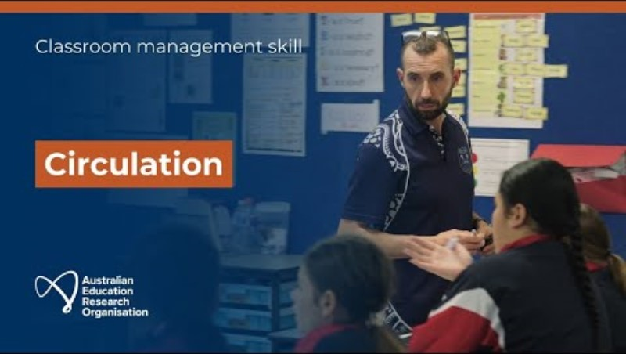
AERO video example of practice: Circulation
Notes:
Preparation
Select at least one example of practice from the video on this slide to show participants. Here are time codes for each example.
00:59 : upper primary
03:42 : lower secondary
06:03 : lower secondary
Check the video for any contextual factors that might distract from the teacher’s actions and words, e.g. uniforms, seating arrangements, room decor, age of students. Mentioning these before watching the video will support participants to focus instead on the classroom practice demonstrated in the video.
Optionally, also prepare a live demonstration of effective circulation or ask a member of staff to prepare a live demonstration. If you or other staff members demonstrate circulation:
rehearse your example using Chapter 15 of the handbook
demonstrate with imaginary students, rather than having members of staff playing students. This will encourage participants to focus on the teacher’s actions during the demonstration
have a specific focus for each circulation
be ready to show your plan and script (a single document that details, in sequence, what you'll do and say), ensuring all participants can see it. It should include:
the focus of each circulation and why you chose it
the circulation routes and why you decided on them.
Prepare to share a reflection on the video or live demonstration, being clear that your own practice is still a work in progress. Identify elements of your own practice that you wish to refine. This can help participants feel safe when rehearsing.
Facilitator notes
While this video depicts other Australian schools and classrooms, the principles of effective practice apply in every context. Therefore, there is much we can learn from it.
Mention any contextual factors in the video that might be distracting. Ask participants to focus on the teacher's words and actions rather than these.
Play selected example(s) from the video.
Share your own reflection from watching the video, including elements demonstrated in the video that you can work on to refine your practice.
If you or other members of staff also model circulation:
demonstrate effective circulation, explicitly identifying each element for success (possibly excluding the final one), either during or after the demonstration
show your plan and script to participants, zooming in on relevant sections. Point out that it addresses the first element for success.
Seek feedback from participants:
What did I do well?
What could I have done differently?
Share your own reflection, including elements that you can work on.
Emphasise that you rehearsed your example before demonstrating today, just as participants will do in this session.

Slide 12
Reflection
Elements for success
Ensure your circulation has
a specific focus.
Pause and scan before circulating
the classroom.
Ensure you can see the majority of the
class as you move around the room.
Scan while you circulate to monitor
all students.
Finish where you started, pause
and scan.
As your practice develops, consider combining more than one focus
for circulation.
What are my key takeaways from
the example or examples I have
just watched?
To what extent do I incorporate the elements for success when I circulate?
Are there specific areas in my classroom(s), or aspects of circulation, that need additional attention?
Does the layout of my classroom support effective circulation? What changes,
if any, could be made to better support effective circulation?
Notes:
Facilitator notes
Give participants 7 minutes to reflect individually and then share in their pairs.

Slide 13
Planning circulation routes
Use a printed seating plan of your classroom or draw one.
Plan and draw your first route around the classroom to focus on students who may require support to start learning tasks.
Select the focus for your second circulation from the list below:
  acknowledging students demonstrating the behaviour expected of them and praising students exceeding expectations specific to them
  encouraging appropriate and respectful peer interactions
  providing additional guidance and support
  helping solve problems hindering students’ active participation in the learning task.
Plan and draw the route for your second circulation.
Notes:
Preparation
You'll need a member of staff to demonstrate rehearsal with you. One of you will rehearse while the other observes and provides feedback. The person rehearsing should use this slide and the next slide to write a plan and script prior to the session. This will mean that you have an example of a plan and script to show participants.
Ensure all participants can see a digital version of your plan and script. Provide hard copies if necessary.
Facilitator notes
Display on the screen a digital version of your plan and script and zoom in to show participants the planned circulation routes and your scripting.
Plan for circulation by following the instructions on this slide. Work with your partner so that you can support each other.
Once you’ve followed the instructions, explain the routes you’ve drawn to your partner.
Give participants 10 minutes to plan their routes and share with their partner.

Slide 14
Planning teacher actions
Your first circulation will focus on assisting students who may require support to start learning tasks.
Your second circulation will focus on one of these:
  acknowledging students demonstrating the behaviour expected of them and praising students exceeding expectations specific to them
  encouraging appropriate and respectful
  peer interactions
  providing additional guidance and support
  helping solve problems hindering students’ active participation in the learning task.
For both circulation focuses:
Identify a situation
when you would have these focuses during circulation.
Plan what you'll do
and script what you'll say during each of the
2 circulations.
Notes:
Facilitator notes
You’ve drawn 2 circulation routes. Your first circulation will focus on assisting students who may require support to start learning tasks. For your second circulation, you selected one of the 4 focuses shown on this slide and have drawn a route for that circulation.
You’re going to plan what you'll do and script what you'll say in a single document to plan your actions and words in sequence. Writing this out helps us refine our choices and increases our confidence when rehearsing in front of each other. When scripting what you'll say, keep in mind that any interactions with students during circulation should be brief.
Show your plan and script, zooming in on relevant sections, to point out the actions you planned and language you scripted.
Once you’ve followed the instructions, share your plan and script, and explain your decisions for what you'll do and say.
Give participants 10 minutes to write their plan and script, and to share them with their partner.
Move from group to group offering support and feedback.

Slide 15
Rehearsal and feedback
  ‘I saw (or heard) you … [refer to element for success].’
  ‘I didn’t see (or hear) you … [refer to element for success].’
Elements for success
Ensure your circulation has a specific focus.
Pause and scan before circulating the classroom.
Ensure you can see the majority of the class as you move around the room.
Scan while you circulate to monitor all students.
Finish where you started, pause and scan.
As your practice develops, consider combining more than one focus for circulation.
Notes:
Preparation
Prepare to demonstrate rehearsing and giving feedback with the other staff member, referring to the steps in the facilitator notes. The person rehearsing should use the plan and script they have prepared.
Decide where participants will rehearse. For example, they could spread out in one large room, or you could allocate a few adjoining classrooms for participants to use. Consider the time it will take for them to get there and back.
When participants observe their partner rehearsing, they will tick the checklist in Section 2.1 of Chapter 15 of the handbook. Consider whether they will do this digitally or whether you need to print copies of the checklist for participants to use.
Facilitator notes
I'm going to demonstrate what rehearsal looks like and then you'll work on refining your circulation, taking turns to rehearse and give each other feedback.
The first 2 sentences on this slide are for when you provide feedback. Always refer to the elements for success, which are in Section 2.1 of Chapter 15 of the handbook. Start with what you saw and heard, referring to the elements that you observed. Then continue with ‘I didn’t see (or hear) you … ’ and refer to the elements that can be added or refined.
Demonstrate rehearsal with the member of staff who you’ve prepared this demonstration with:
Explain that you’re going to demonstrate rehearsing, providing feedback and rehearsing again.
Explain who will be the ‘teacher’ and who will be the ‘observer’.
Briefly explain each role. The ‘teacher’ will rehearse. The ‘observer’ will check off the items they see and hear during the rehearsal, referring to the elements for success. The ‘observer’ will then provide feedback to the ‘teacher’.
Explain that the ‘teacher’ will demonstrate the first circulation, which is focused on assisting students who frequently require support to start learning tasks.
The ‘teacher’ demonstrates a circulation that includes some, but not all, elements for success. The ‘observer’ ticks the checkboxes in Section 2.1 of Chapter 15 of the handbook to indicate the elements for success that are demonstrated.
The ‘observer’ demonstrates providing feedback using the 2 sentence starters on this slide.
The ‘teacher’ demonstrates circulation again, with the same circulation focus, addressing the feedback as best as possible and incorporating more or all of the elements of success.
The ‘observer’ again demonstrates providing feedback using the 2 sentence starters on this slide.
Invite questions or feedback on your demonstration of rehearsal.
Remember that rehearsal is always iterative. One of you will keep rehearsing and seeking feedback on your first circulation for 5 minutes, refining your circulation each time. This might include revising your plan and script before rehearsing again. Use the checklist in Section 2.1 of Chapter 15 of the handbook when you observe and provide feedback. Swap roles after 5 minutes. Then repeat this for your second circulation focus, again swapping roles after 5 minutes.
Before sending participants to their rehearsal areas, inform them of their expected return time.
While people are rehearsing, observe as many people as possible, encouraging them to re-rehearse so that their refined practice becomes automatic. Towards the end of the 20 minutes, tell participants how much time they have left.

Slide 16

Reflection
What have I learned about effective circulation that I will make sure I include in my own practice?
Do I need support to refine this skill? If so, what support do I need?
How will I know if I’ve been successful in refining my practice?
Notes:
Preparation
Prepare to explain the support available to participants while they practise circulation after today. For example:
Who will be available to observe them and provide feedback, and how do they request this?
Who can they talk to and seek advice from? This might include individuals or professional learning communities in the school.
The checklists in the handbook can support them to practise and reflect on their practising.
AERO’s video examples of practice for circulation can support them to review effective practice. https://www.edresearch.edu.au/guides-resources/videos/circulation-classroom-management-skill
Prepare an email, to be sent after the session reminding participants of the support available to them, including hyperlinks to relevant resources.
To guide future sessions and identify additional support needs, prepare ways to collect participants' responses to the questions on this slide (anonymously, if preferred), such as sticky notes or an online survey.
Facilitator notes
Outline the support available to participants as they continue to refine their use of circulation.
Give participants 5 minutes to:
reflect individually and record their reflections
discuss these questions in their pairs
Recording the reflections will help to inform future sessions and to identify further support needs.
Then invite participants to share learning with the whole group.
Optionally, invite reflection on the rehearsal process to build the culture of rehearsal and feedback.
How did the process of planning, scripting, rehearsing and receiving feedback assist you today?

Slide 17
Reflection on practising
When did I practise the skill?
What elements for success did I focus on refining?
What did I learn by practising the skill?
What impact has refining the skill had on students’ engagement in learning?
What can we celebrate?
What are my next steps in refining the skill?
Notes:
Preparation
Schedule a session of 10 to 15 minutes, 2 weeks after this session for staff to share their experiences of practising the skill in their classrooms.
Facilitator notes
Over the next 2 weeks, practise circulation with your students. Practising a skill is not just using it. It also involves planning, reflecting and, where possible, seeking feedback.
We will meet in 2 weeks time to reflect on the questions on this slide.
Give participants time to read the questions.
Please consider when you'll practise this routine and set some calendar reminders for yourself. This will help you answer the first question when we meet.
Give participants a minute to set some calendar reminders for themselves.
Outline the support available to participants over the next 2 weeks.

Slide 18

Notes:
More copyright information: https://creativecommons.org/licenses/by/4.0/deed.en

